Slide 1
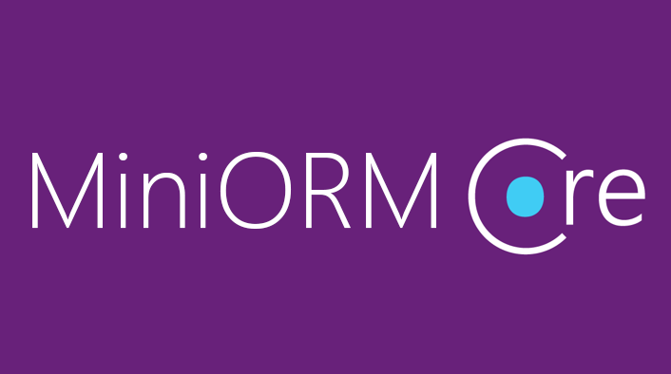
Custom ORM Framework
Overview and Features

Slide 2
MiniORM Core: Overview
Designed after Entity Framework Core
Provides LINQ-based data queries and CRUD operations
Change tracking of in-memory objects
Maps navigation properties
Maps collections
One-to-many, Many-to-many, etc.

Slide 3
MiniORM Core Workflow: Overview
Define data model (database-first)
Entity Classes
DbContext (with DbSets)
Initialize DbContext
Using connection string
Query data using context
Manipulate data (add/remove/update entities)
Context gets persisted into database

Slide 4
MiniORM Components (1)
The DbContext class
Holds the database connection and the DB Sets
Provides LINQ-based data access
Provides change tracking, and an API for CRUD operations
DBSets
Hold entities (objects with their attributes and relations)
Each database table is typically mapped to a single C# class

Slide 5
MiniORM Components (2)
Associations (relationship mappings)
An association is a primary key / foreign key-based relationship between two entity classes
Allows navigation from one entity to another
MiniORM supports one-to-one, one-to-many and many-to-many relationships
var courses = student.Courses.Where(…);

Slide 6
ChangeTracker: Cloning Entities (MiniORM)
In order to check for entity modification, the change tracker clones all entities on initialization
Cloning process:
Create new blank instance of entity
Find all properties, which are valid SQL types
Set blank instance’s property values to existing entity values

